Slide 1
CS 499/CS 579: Enterprise Defense
Day 4: Applied Computer Networking
Notes:
Overarching goal: What is the bare minimum my computer needs to do such that I can browse to https://www.xyz.com?

Slide 2
Overview
Networking concepts for cyber ninjas
Networking hardware
Protocol suites
Exercise #1 – Routing/Switching/Encapsulation
Introduction to Networking Protocols
Exercise #2 – Port Scanner

Slide 3
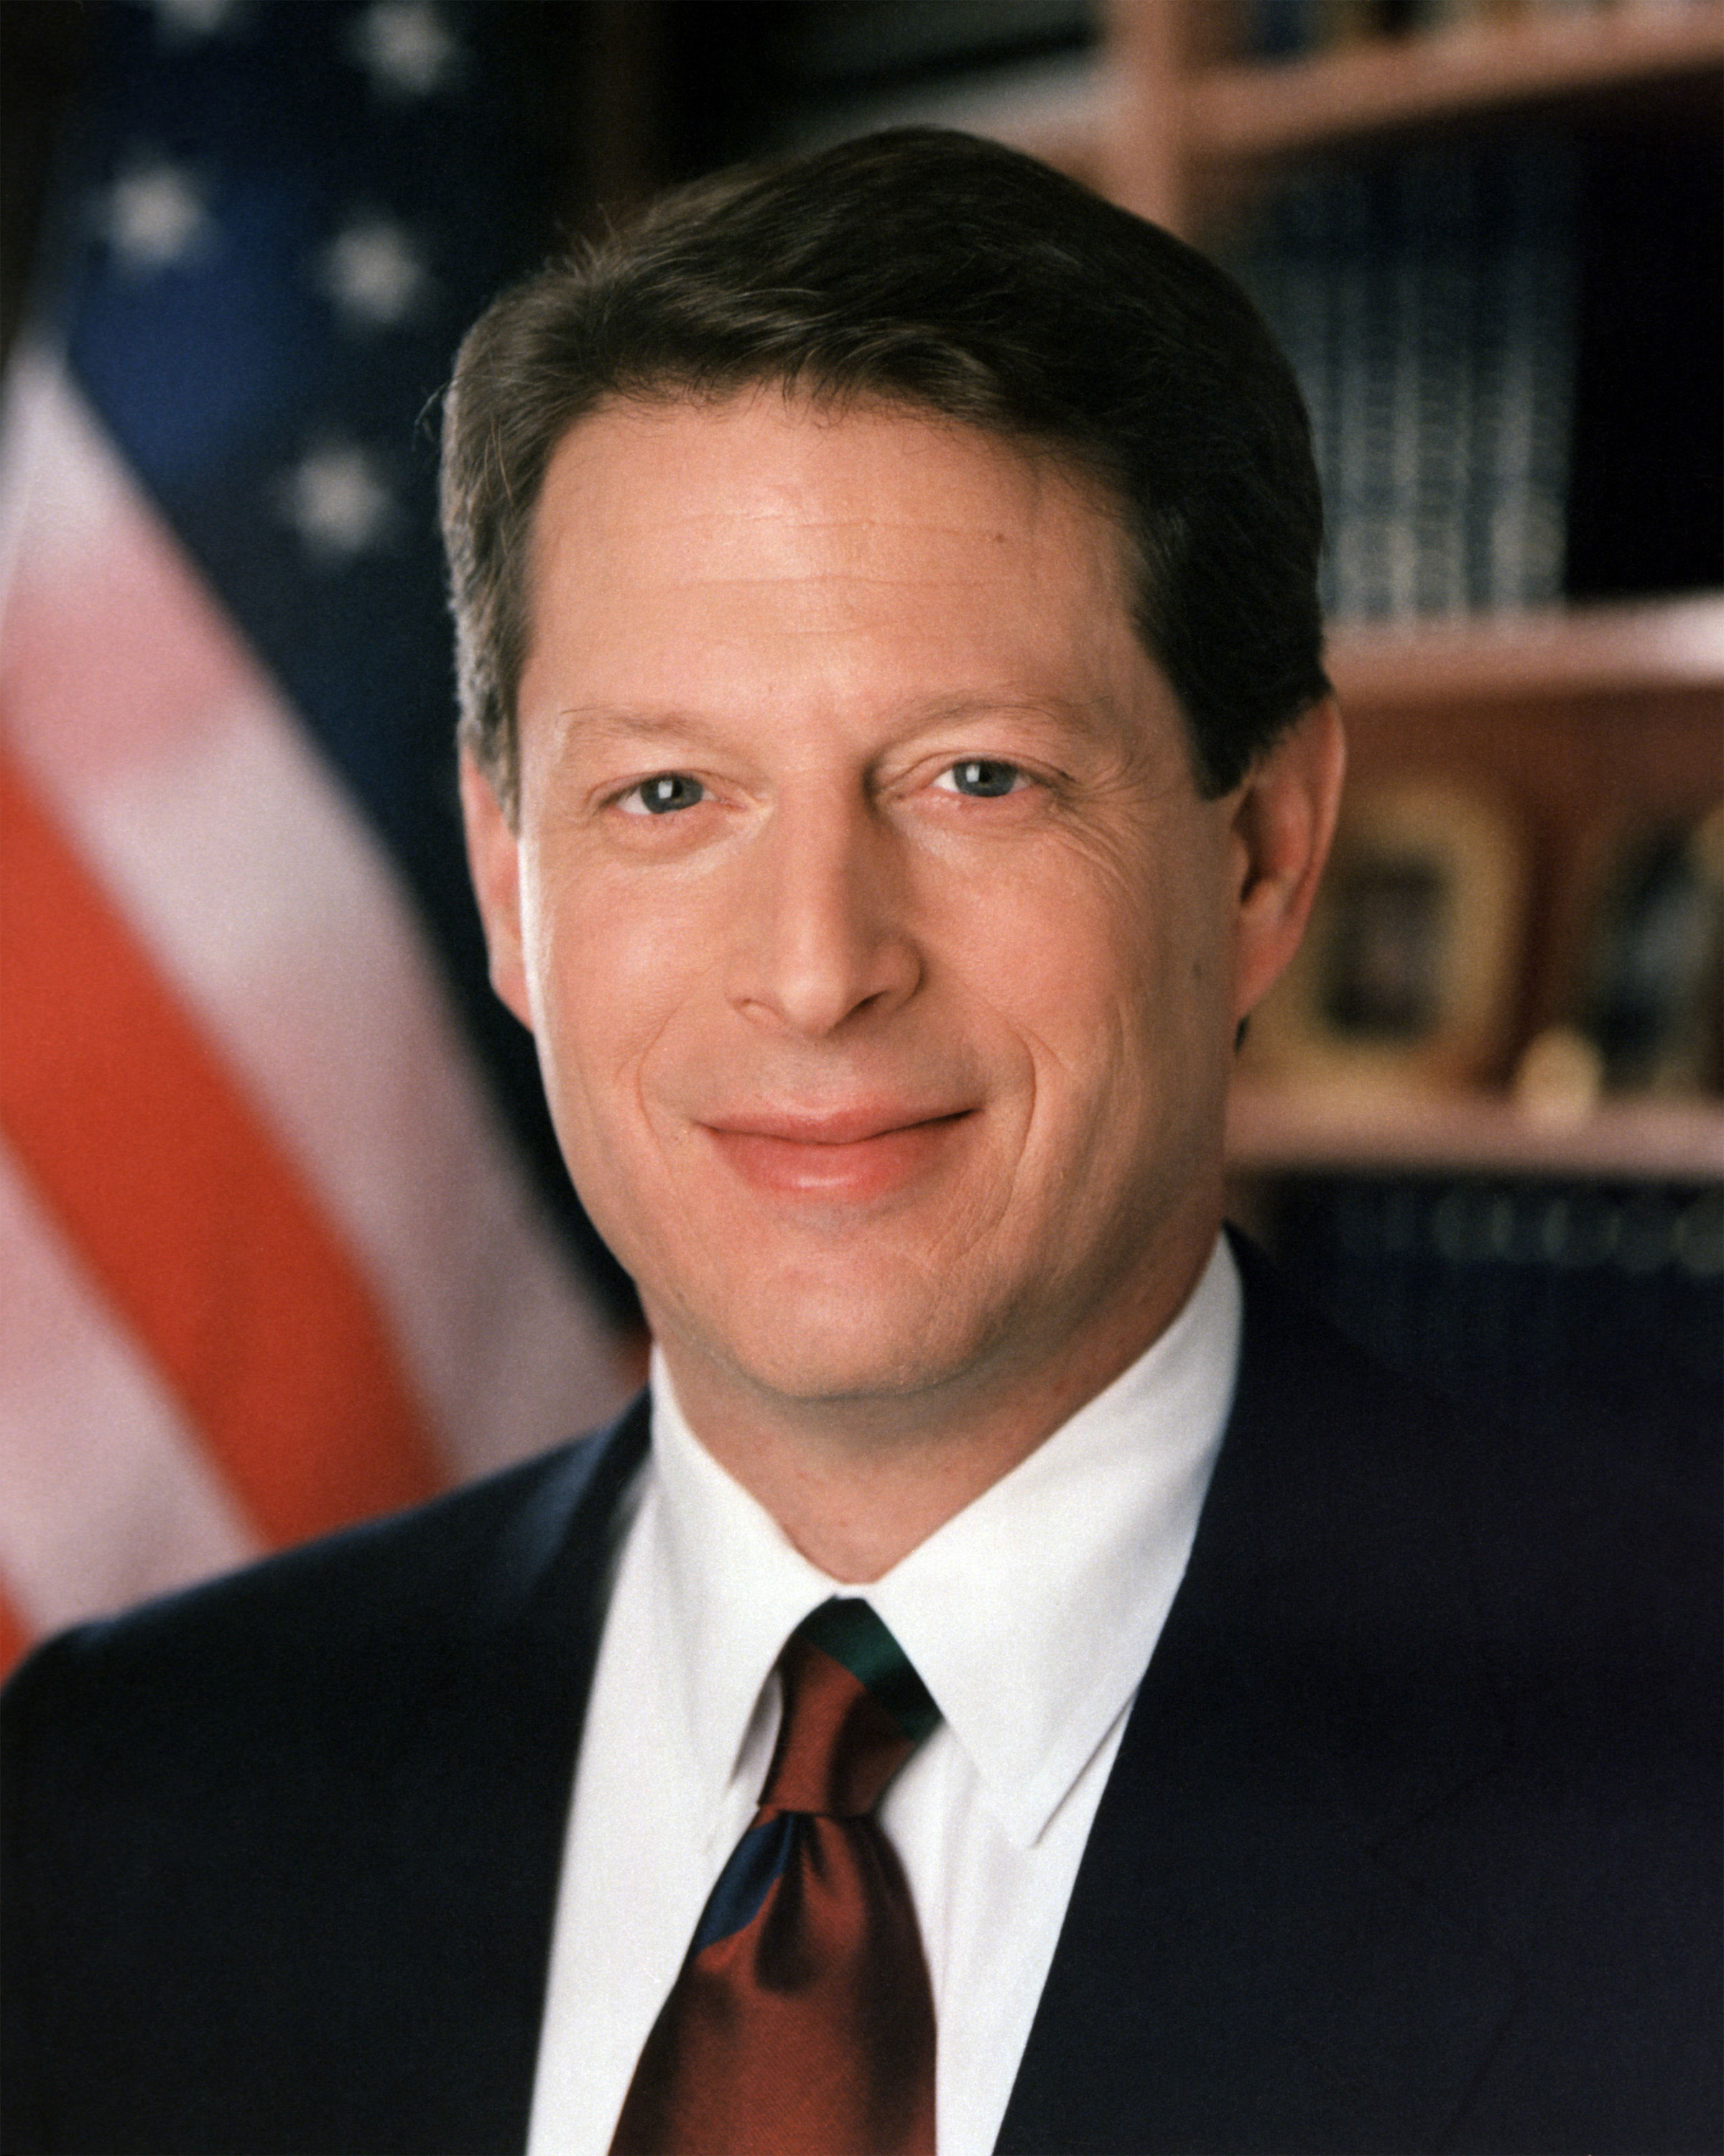
How Do Computers Talk?
“I don’t know, I just plug it in”
“Wi-Fi?”
“The Information Superhighway”
Source: Wikipedia

Slide 4
What’s a Network? Why Use One?
A network is a series of interconnected devices
Typically referred to as “nodes” or “hosts”
Relies on various protocols for communicating
Protocols function as “rules”
Notes:
Hosts can be very different (HW, OS, purpose, etc.)
Think Linux vs Windows vs UNIX
User v. server
Embedded (IoT) vs. Personal Use
Protocols serve as the rules of the road, specifying:
Connection Status
Addressing
Flow Control
Order of Data
Error Correction
Data Encoding

Slide 5
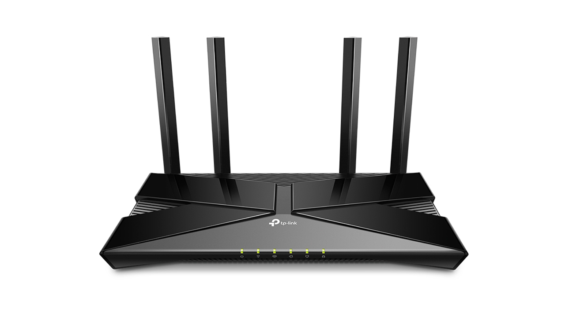
Common Networking Hardware
Source: tp-link

Slide 6



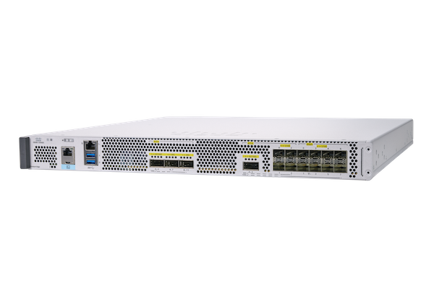
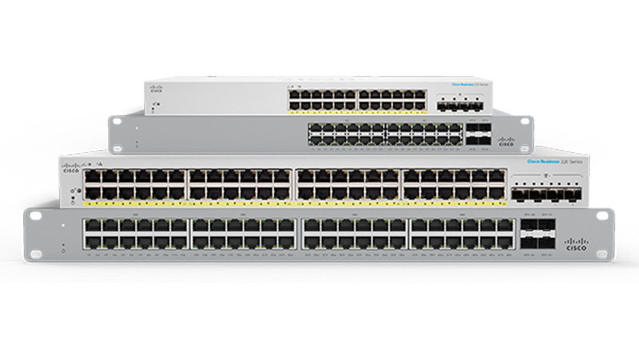
Common Networking Hardware
Source: Cisco

Slide 7
Routers
Determines optimal route to deliver data
Global actions
Source: Cisco
Notes:
Routing protocols exist on routers to optimize traffic (e.g., BGP, OSPF, RIP, etc. ← not required for the midterm, just fun facts).
Routers act globally, i.e., they can see both internal to their networks and communicate with the outside Internet

Slide 8
Switches
Handles switching aka forwarding
Locally forwards data from:
Router -> Hosts
Hosts -> Router
Self-learning
Source: Cisco
Notes:
Handles switching… duh.
Forwards data from router to hosts and back. Cannot communicate with outside Internet.

Slide 9
Hosts
Sends messages
Broken down into “packets”
Connected to other devices via links
Has a MAC address (48-bits)
HW address
Also has an IP address (32-bits)
Network layer address
Source: Cisco
Notes:
Your computer.

Slide 10
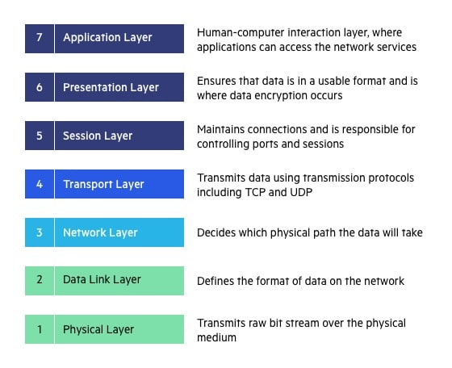
Introducing the OSI Model
Source: Cloudflare
Notes:
Just kidding… Enterprise Defense isn’t 100% about networking.
As such, we don’t care about OSI.

Slide 11
(Re-) Introducing the TCP/IP Suite
Two separate protocols jammed together
Creates a comprehensive, practical model
Truncates the ugly OSI model into 4 layers
Notes:
Much more practical way of understanding computer networking if you don’t require a granular understanding

Slide 12
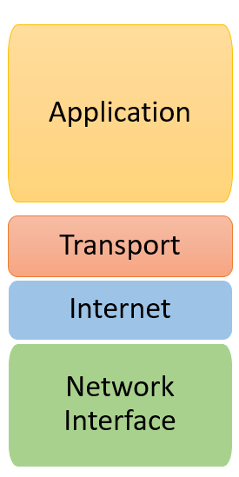
TCP/IP Suite
Source: Guru99
Notes:
Starting with the Network Interface Layer – this handles communications between two hosts on the same network. Hardware connects directly to a network medium, such as coaxial cable, fiber optic, or various Ethernet cables (twisted-pair, crossover).
Internet Layer – Sending packets occurs here. Routing protocols and network address management exist at this layer. IP is a protocol at this layer.
Transport Layer – Flow of data (how much and rate) exists here. May correct errors and ensures the sequence of data is correct. TCP and UDP are common Transport Layer protocols.
Application Layer – Closest to the user of the system, involves software for the user to use.

Slide 13

A Note on Encapsulation
Source: Russian American Company
Notes:
Imagine you ship a notional item overseas. You have the address of the recipient. You put the notional item in a box, put the label on it, and send it.
The shipping service puts it in a truck, drives it to a plane, where it gets loaded into a bigger box. It flies to another country, then… rinse and repeat.

Slide 14
Exercise #1

Slide 15
Let’s Dive Into Some of the Protocols…
ARP
DHCP
DNS
TCP
UDP
HTTPS
Notes:
Goal: Using the TCP/IP Suite, how does our computer request an HTTP(S) webpage?

Slide 16
Domain Name System - DNS
What identifiers do people use?
Names, SSNs
What identifiers do computers use?
IP addresses, MAC addresses
Provides easy-to-remember domain names
E.g. google.com as opposed to 142.251.211.238
Authoritative “root” DNS servers exist

Slide 17

Address Resolution Protocol - ARP
Maps IP to MAC address
Entries are stored in an ARP table on each host
What if we know a device exists but don’t know its MAC?

Slide 18

Dynamic Host Configuration Protocol - DHCP
Computers need to get IP addresses somehow
DHCP consists of a 4-step process:
Discover
Offer
Request
Acknowledge
Source: Wikipedia

Slide 19
Transmission Control Protocol - TCP
Point-to-point, reliable communications
Reliable due to Three-Way Handshake
Based on the protocol specification
Sender will not overwhelm
Flow control

Slide 20
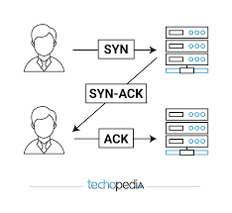
Transmission Control Protocol - TCP
Source: freecodecamp

Slide 21
User Datagram Protocol - UDP
Connectionless, no frills
“Fire and forget” transmission
Best effort – may lose packets

Slide 22
Hypertext Transfer Protocol Secure - HTTPS
Same as HTTP… but improved!
Uses Transport Layer Security (TLS), previously Secure Sockets Layer (SSL)
Client-server based
Client request Web objects (e.g., HTML) addressable via a URL
Server provides Web objects in response

Slide 23
Transport Layer Security - TLS
Verifies identity of the website and creates an encrypted session
Asymmetric key encryption
Handshake-based, resulting in a session key

Slide 24
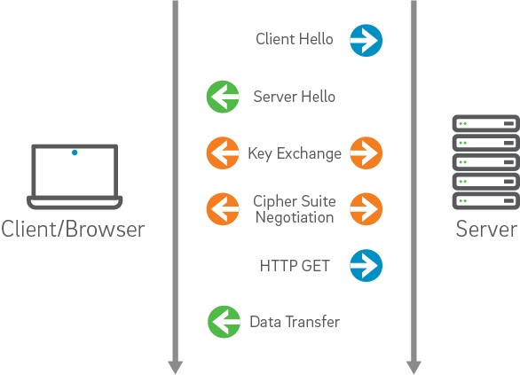
Transport Layer Security - TLS
Source: Vikingcloud

Slide 25
Goal:
Using the TCP/IP Suite, how does our computer request an HTTP(S) webpage?
Notes:
UDP:
Our computer needs to get an IP address, where do we start? (DHCP, encapsulated in UDP)
Our computer then needs to get the IP address of the router, how do we find that? (ARP query and reply). Computer updates the ARP table with the MAC and IP of the router (aka the first hop).
Now, DNS occurs – this is once again, encapsulated, in UDP. Goes to our switch (if using), then to the router. Forwarded until it reaches an authoritative name server. If the DNS lookup is cached locally (i.e., by our router), we’ll get a non-authoritative answer. This can be a problem.
TCP:
Finally, we can browse, as a user using an application, to a website. This browsing opens up at TCP socket (containing an IP address and a port number).
The TCP three-way handshake (Sender SYN, Receiver SYNACK, and Sender ACK) occur.
Now the connection is established, and we can send an HTTP(S) request over the TCP socket.

Slide 26
Break Time!

Slide 27
Exercise #2 – Build Your Own Port Scanner
Using a language of your choice
Design a simple, TCP scanner
Scan ports 1-65535
Print out findings to terminal or to a file (your call)
Target: scanme.nmap.org
Notes:
Some Hints:
Socket library
For loop
Take an argument from the user via CLI for the target to scan
Please try to avoid Googling “xyz language tcp scanner”
Point towards documentation for language

Slide 28
Some Hints
Socket library
For loops are your friends
Take an argument from the user via CLI for the target to scan
Please try to avoid Googling “xyz language tcp scanner”

